Slide 1
Bioinformatics Producing and Analysing Sequence Alignments
Assoc. Prof. Dr. Gazi Erkan BOSTANCI
Slides are mainly based on ‘Understanding Bioinformatics’ by Marketa Zvelebil and Jeremy O. Baum

Slide 2
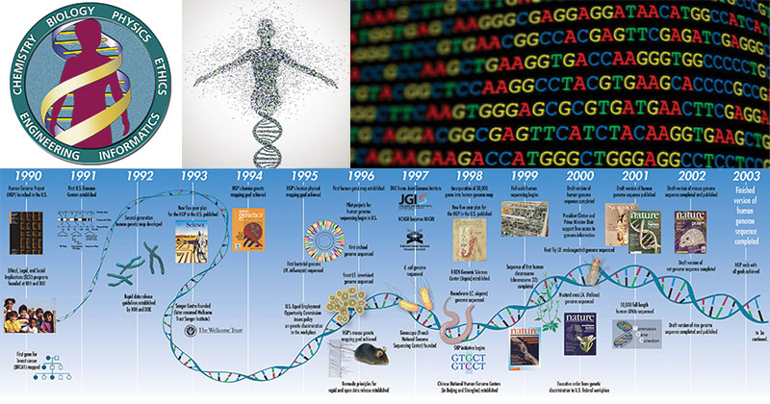
The revolution in genetic analysis that began with recombinant DNA technology and the invention of DNA sequencing techniques in the 1970s has, 30 years later, filled vast databases with nucleotide and protein sequences from a wide variety of organisms.

Slide 3

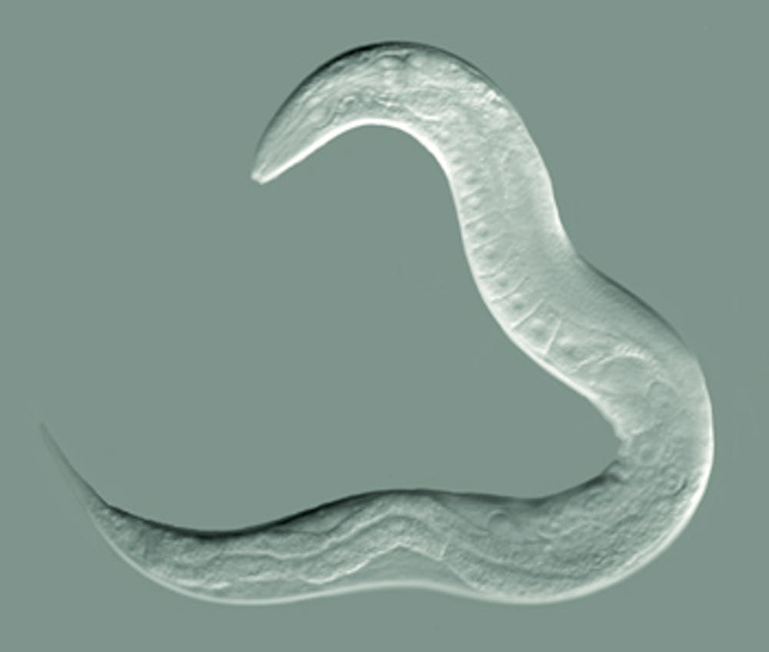
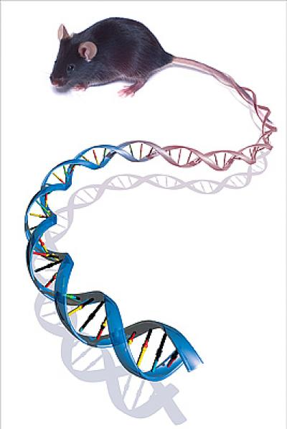
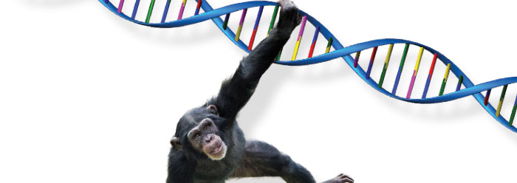
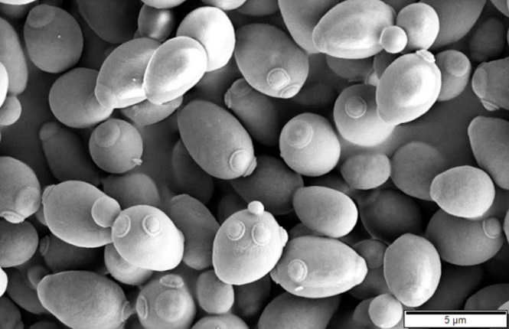
Genomes that have now been completely sequenced include human, mouse, chimpanzee, the fruit fly Drosophila, the nematode Caenorhabditis, and the yeast Saccharomyces, as well as numerous bacteria, archaea, and viruses.

Slide 4
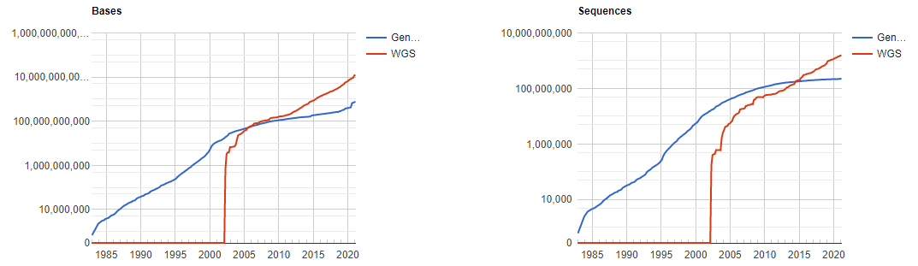
Although entries for nucleotide and protein sequences in databases such as GenBank, dbEST, and UniProt KB now number many millions, nothing is known about the structure or function of the proteins specified by many of them. Converting this sequence information into useful biological knowledge is now the main challenge.
GenBank and WGS Database Statistics

Slide 5
To find out more about a newly determined sequence, it is subjected to the process of sequence analysis. There are many aspects to this, depending on the source of the sequence and what we ultimately want to find out about it.
Today, we will focus on one of the key stages in most sequence analyses:
the alignment of different sequences to detect homology and
the comparison of a novel sequence with those in the databases to see whether there is any similarity between them.
The practical use of techniques and programs for general alignment, database searching, and pattern searching will be described in this chapter, with the main focus on the alignment and analysis of protein sequences.

Slide 6
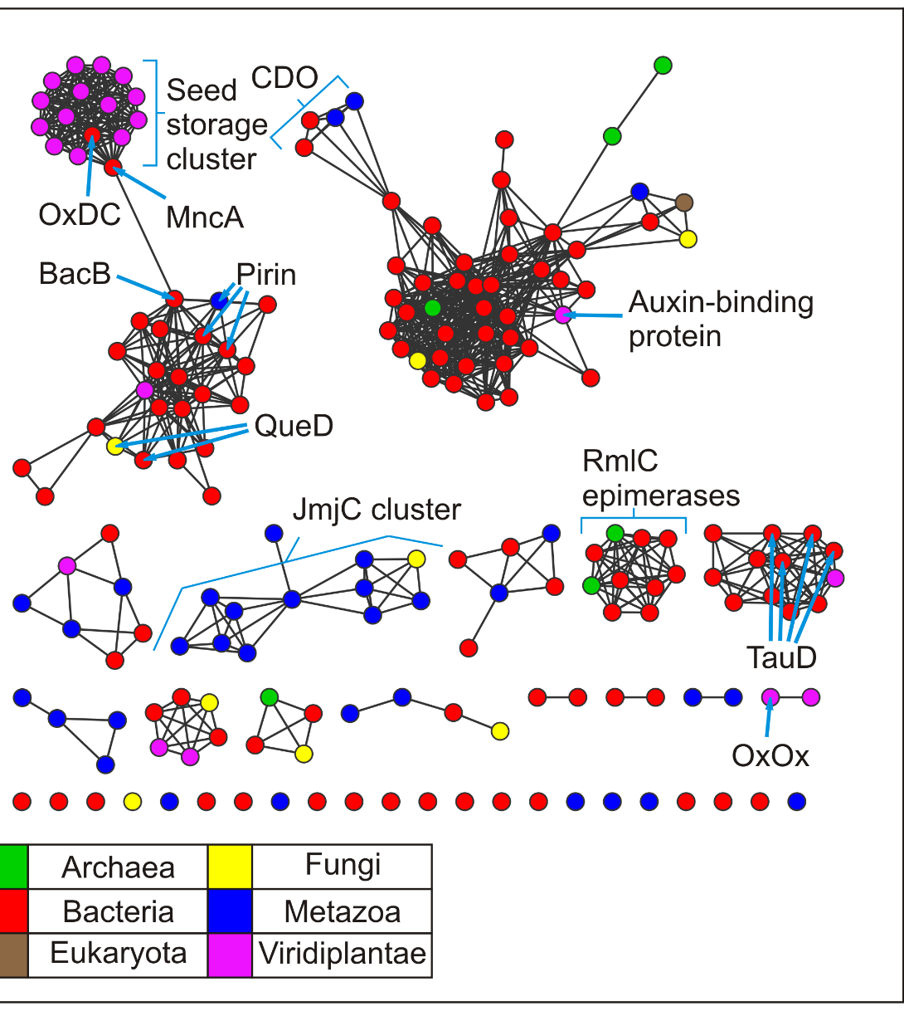
The identification of similar sequences has a multitude of applications. For raw, uncharacterized genomic DNA sequences, comparison with sequences in a database can often tell you whether the sequence is likely to contain, or be part of, a protein-coding gene.
The similarity search may retrieve a known gene or family of genes with a strong similarity to the new sequence. This will provide the first clues to the type of protein the new gene encodes and its possible function.
Similarities in sequence can also help in making predictions about a protein’s structure.
Protein Similarity Networks

Slide 7
Principles of Sequence Alignment
Devising ways of comparing sequences has never been straightforward, not just because of the vast amounts of information now available for searching.
The difficulties arise because of the many ways DNA and protein sequences can change during evolution.
Mutation and selection over millions of years can result in considerable divergence between present-day sequences derived from the same ancestral gene.
Bases at originally corresponding positions, and the amino acids they encode, can change as a result of point mutation, and the sequence lengths can be quite different as a result of insertions and deletions (indels).
Even more dramatic changes may have occurred; for example, the fusion of sequences from two different genes.

Slide 9
On superficial inspection, such changes in gene sequence and length can effectively mask any underlying sequence similarity. To reveal it, the sequences have to be aligned with each other to maximize their similarities.
Alignment methods are at the core of many of the software tools used to search the databases.

Slide 10
Alignment is the task of locating equivalent regions of two or more sequences to maximize their similarity
As the result of mutation, even the sequences of the same protein or gene from two closely related species are rarely identical.
Ideally, what we want to achieve when comparing sequences is to line them up in such a way that, when they do derive from a common ancestor, bases or amino acids derived from the same ancestral base are aligned.
Without information to the contrary, this is best achieved by maximizing the similarity of aligned regions.

Slide 11
To illustrate the general principle, take the two hypothetical amino acid sequences THISSEQUENCE and THATSEQUENCE. If we align them so that as many identical letters as possible pair up we get
where the letters in red type are identical. As we can easily see with such short and similar sequences, this alignment clearly identifies their strong similarity to each other.

Slide 12
So far so good, but when sequences become more different from each other, they become more difficult to compare. How would we go about comparing the two sequences THATSEQUENCE and THISISASEQUENCE, in which a mutation has led to the insertion of the three amino acids I, S, A into one of the original sequences?
Simply lining them up from the beginning loses much of the similarity we can see exists. More subtly, because of the difference in length, it also creates false matches between noncorresponding positions.

Slide 13
To get round this problem, gaps are introduced into one or both of the sequences so that maximum similarity is preserved.
There is never just one possible alignment between any two sequences, and the best one is not always obvious, especially when the sequences are not very similar to each other.
At the heart of sequence-comparison and database-searching methods are algorithms for testing the fit of each alignment generated, giving it a quantitative score, and filtering out the unsatisfactory ones according to preset criteria.

Slide 14
In all methods of sequence comparison, the fundamental question is
whether the similarities perceived between two sequences are due to chance, and are thus of little biological significance,
or whether they are due to the derivation of the sequences from a common ancestral sequence, and are thus homologous.
The terms “homology” and “similarity” are sometimes used interchangeably, but each has a distinct meaning!

Slide 15
Similarity is simply a descriptive term telling you that the sequences in question show some degree of match.
Homology, in contrast, has distinct evolutionary and biological implications. In the molecular biological context, it is generally defined as referring specifically to similarity in sequence or structure due to descent from a common ancestor.
Homologous genes are therefore genes derived from the same ancestral gene. During their evolutionary history they will have diverged in sequence as a result of accumulating different mutations.

Slide 16
Scoring Alignments
Two homologous sequences are often so different that a correct or best alignment is not obvious by visual inspection. Furthermore, the large numbers of sequences that can be examined for similarity nowadays oblige us to use automated computational methods to judge the quality of an alignment, at least as an initial filter.
Because it is possible for two sequences to be aligned in a variety of different ways, including the insertion of gaps to improve the number of matched positions, how does one objectively determine which is the best possible alignment for any given pair of sequences?
In practice, this is done by calculating a numerical value or score for the overall similarity of each possible alignment so that the alignments can be ranked in some order.

Slide 17
We can then work on the basis that alignments of related sequences will give good scores compared with alignments of randomly chosen sequences, and that the correct alignment of two related sequences will ideally be the one that gives the best score.
The alignment giving the best score is referred to as the optimal alignment, while others with only slightly worse scores are often called suboptimal alignments.
No one has yet devised a scoring scheme that perfectly models the evolutionary process, which is so complex that it defies any practical method of modeling.
The implication of this is that the best-scoring alignment will not necessarily be the correct one, and conversely, that the correct alignment will not necessarily have the best score.

Slide 18
The simplest way of quantifying similarity between two sequences is percentage identity
Identity describes the degree to which two or more sequences are actually identical at each position, and is simply measured by counting the number of identical bases or amino acids matched between the aligned sequences. Identity is an objective measure and can be precisely defined.
Percentage or percent identity is obtained by dividing the number of identical matches by the total length of the aligned region and multiplying by 100.

Slide 19
For the THATSEQUENCE/THISISASEQUENCE comparison, the alignment given below is the best that can be achieved, and has a percentage identity score of 68.75% (11 matches over a total length of 16 positions, including the gaps).

Slide 20
One might think that an alignment of completely unrelated sequences would have a percentage identity of zero. However, as there are only 4 different nucleotides in nucleic acid sequences, and only 20 different amino acids in protein sequences, there is always a small but finite probability for any aligned sequences that identical residues will be matched at some positions.
Because there are often hundreds of residues in a protein sequence and thousands in a nucleotide sequence, unrelated sequences are expected to align matches at several positions.
The length of the sequence matters: a 30% identity over a long alignment is less likely to have arisen by chance than a 30% identity over a very short alignment.

Slide 21
The dot-plot gives a visual assessment of similarity based on identity
A dot matrix or dot-plot is one of the simplest ways to compare sequence similarity graphically, and can be used for both nucleotide and protein sequences.
To compare two sequences X and Y, one sequence is written out vertically, with each residue in the sequence represented by a row, while the other is written horizontally, with each residue represented by a column.

Slide 22
Each residue of X is compared to each residue of Y (row to column comparison) and a dot is placed where the residues are identical.
In the simplest scoring system, identical residues are scored as 1 and nonidentical residues as 0, and dots are placed at all positions that contain a 1.

Slide 23
For example, if we take the pair THISSEQUENCE/THISISASEQUENCE pair, then a simple dot-plot will look like that illustrated in the figure.
The dots in red, which form diagonal lines, represent runs of matched residues.
The pink dots scattered either side of the diagonals are the same residues found elsewhere in the sequence.
The diagonals are interrupted by a few cells, where a gap has been inserted.

Slide 24
Dot-plots suffer from background noise
To overcome this problem it is necessary to apply a filter
The most-commonly used filtering method uses a sliding window and requires that the comparison achieves some minimum identity score summed over that window before being considered.

Slide 25
Check
https://bioboot.shinyapps.io/dotplot/
for an interactive application.

Slide 26
Substitution Matrices
For alignments of protein sequences, the score is assigned to each aligned pair of amino acids is generally determined by reference to a substitution matrix, which defines values for all possible pairs of residues.
Various types of substitution matrices have been used over the years. Some were based on theoretical considerations, such as the number of mutations that are needed to convert one amino acid into another, or similarities in physicochemical properties.
The most successful, however, use actual evidence of what has happened during evolution, and are based on analysis of alignments of numerous homologs of well-studied proteins from many different species.

Slide 27
The choice of which substitution matrix to use is not trivial because there is no one correct scoring scheme for all circumstances. There is a wide range of variation in the similarity of sequences, from almost complete identity to a few percent.
On one occasion we may need to align and score closely related sequences, whereas on another we may want to identify very distant relationships reliably.
In the first case, the scoring scheme should be strongly biased toward giving high values to perfect matches and highly conserved substitutions.
In the second case, a wider range of substitutions should be treated favorably.

Slide 28
Most scoring schemes for amino acid sequences use as reference a 20 x 20 substitution matrix, representing the 20 amino acids found in proteins.
Each cell of the matrix is occupied by a score representing the likelihood that that particular pair of amino acids will occupy the same position through true homology, compared to the likelihood of their occurring as a random match.
The most important scoring matrices will be described below, with general guidance as to which one to use when.

Slide 29
Amino acid substitution scoring matrices. (A) The BLOSUM-62 matrix and (B) the PAM120 substitution matrix. Each cell represents the score given to a residue paired with another residue (row x column). The colored shading indicates different physicochemical properties of the residues: small and polar, yellow; small and nonpolar, white; polar or acidic, red; basic, blue; large and hydrophobic, green; aromatic, orange.

Slide 30
When an alignment is made, each aligned amino acid pair is given a score from the substitution matrix. These scores are then summed to give the overall score (S) of the alignment. For example, using the BLOSUM-62 matrix we would score our example alignment as follows (in this case “U” represents an unknown residue; that is, a residue that could not be identified by sequencing techniques and is thus not given a score).
Therefore the overall score S for this alignment equals 52.

Slide 31
The choice of substitution matrix depends on the problem to be solved
With many scoring matrices available, it is hard to know which one to use. Within a group of matrices such as the PAM or BLOSUM series, different ones, for example PAM250 versus PAM120 or BLOSUM-50 versus BLOSUM-80, are more suitable for different types of problem.
The PAM matrix number indicates evolutionary distance whereas the BLOSUM matrix number refers to percentage identity.
When aligning sequences that are anticipated to be very distantly related, matrices such as PAM250 and BLOSUM-50 may therefore be preferable. PAM120 and BLOSUM-80 may perform better for more closely related sequences.

Slide 32
Inserting Gaps
Homologous sequences are often of different lengths as the result of insertions and deletions (indels) that have occurred in the sequences as they diverged from the ancestral sequence.
Their alignment is generally dealt with by inserting gaps in the sequences to achieve as correct a match as possible.
To signify that an insertion or deletion has occurred, a letter or stretch of letters in one sequence is paired up with blank spaces (usually indicated by hyphens) inserted into the other sequence to achieve a better match.

Slide 33
Gaps must be introduced judiciously: forcing two sequences to match up simply by inserting large numbers of gaps will not reflect reality and will produce a meaningless alignment. To place limits on the introduction of gaps, alignment programs use a gap penalty: each time a gap is introduced, the penalty is subtracted from the score, decreasing the overall score of the alignment.
Structural analysis has shown that fewer insertions and deletions occur in sequences of structural importance, and that insertions tend to be several residues long rather than just a single residue long. This information can be included in the scoring scheme by placing a smaller penalty on lengthening an existing gap (gap extension penalty) than on introducing a new gap, thus penalizing single-residue gaps relatively more.
The best alignment is thus the one that returns the maximum score for the smallest number of introduced gaps.

Slide 34
Dynamic programming algorithms can determine the optimal introduction of gaps
In practice, it is nearly always necessary to insert gaps into sequences when aligning them. The most obvious way of finding the best alignment with gaps would be to generate all possible gapped alignments, find the score for each, and select the highest-scoring alignment. This would be enormously time consuming, however.
For example, approximately 10⁷⁵ alignments would need to be generated for a sequence of only 100 residues. It only became practicable to incorporate gaps into an alignment with the development of dynamic programming algorithms.
These avoid unnecessary exploration of the bulk of alignments that can be shown to be nonoptimal. The name “dynamic programming” reflects the fact that the precise behavior of the algorithm is established only when it runs (in other words, dynamically) because it depends on the sequences being aligned.

Slide 35
The first algorithm to use dynamic programming for sequence comparison was that of S. B. Needleman and C. D. Wunsch, published in 1970. Their technique is still the core of many present-day alignment and sequence-searching methods.
In their method, gaps, regardless of length, have an associated penalty score; newer methods use more complicated gap penalties. The actual values of the gap scores can be varied depending on the type of scoring matrix being used.
One rule always followed is that gaps can never be aligned with each other.

Slide 36
Types of Alignment
The general principles outlined in the previous sections can be used to make different types of alignment.
Two closely related homologous sequences will generally be of approximately the same length, so that their alignment will cover the full range of each sequence.
This is referred to as a global alignment, and is generally the appropriate one to use when you want to compare or find closely related sequences that are similar over their whole length.

Slide 37
On the other hand, there are many cases where only parts of sequences are related.
A simple example is the amino acid sequences of two proteins each consisting of two domains, with only one domain common to both proteins and the other domains completely unrelated. In this case, the only meaningful alignment will be a local alignment of the shared domain.
Looking only at global alignments may not reveal the limited but important similarity between the sequences. This is particularly the case for comparisons between multidomain proteins, such as PI3-kinases, which consist of a number of small protein domains strung together.
Local alignment programs are therefore useful for detecting shared domains in such proteins.

Slide 38
When searching through a sequence database with a query sequence from an unknown protein, local alignment is a very useful tool to use initially.
Once sequences with regions of high similarity are found using local alignment, global alignment can be used to align the rest of the sequence that is not so similar.
Local alignment is also a good tool for identifying particular functional sites from which sequence patterns and motifs can be derived.

Slide 39
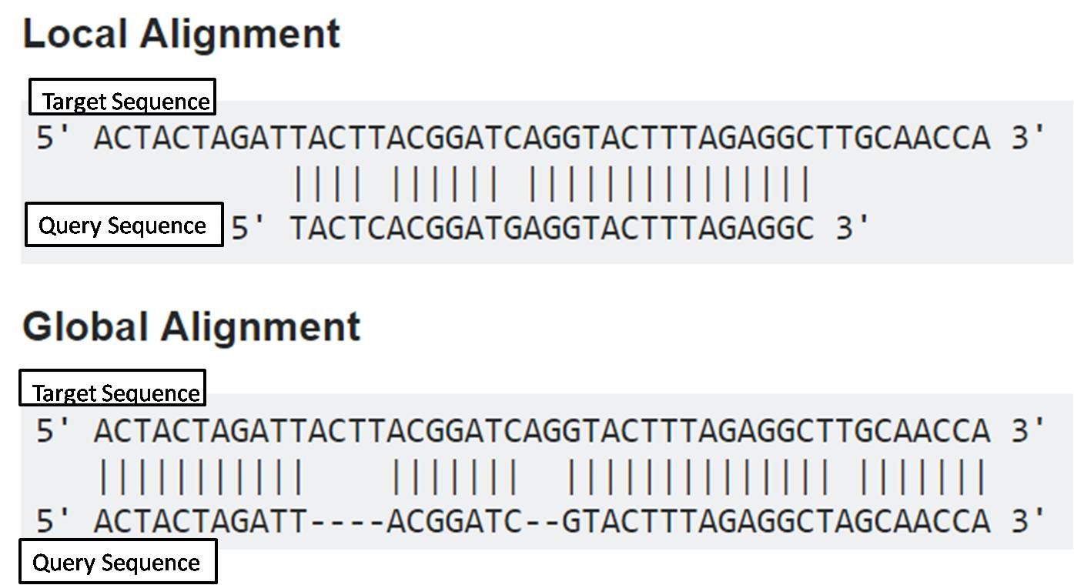

Slide 40
A widely used local alignment algorithm is the Smith–Waterman algorithm, which is a modification of the Needleman–Wunsch algorithm. Instead of looking at each sequence in its entirety, which is what the Needleman–Wunsch algorithm does, the Smith–Waterman method compares segments of all possible lengths and chooses the segment that optimizes the similarity measure.
The scoring matrix used must include both positive and negative scores, and only alignments with a positive total score are considered. Therefore, if on extending the alignment at a particular step none of the possible alignments has a positive score, all previous alignments are rejected, and new ones are considered starting from that point.
This makes the calculation sensitive to the precise match and mismatch scores and gap penalties.

Slide 41
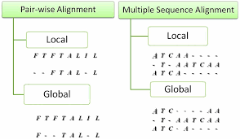
For both global and local alignments, methods exist for making pairwise alignments, that is, the alignment of just two sequences, and for making multiple alignments, in which more than two sequences are aligned with each other.
We have mainly used examples of pairwise alignments to illustrate the general principles of alignment scoring and quality assessment.
Multiple alignment introduces yet another dimension to the computational problems of alignment.

Slide 42
Tree or hierarchical methods of multiple alignment are widely used, for example in the multiple alignment program ClustalW.
This method first compares all the sequences in a pairwise fashion, then performs a cluster analysis on the pairwise data to generate a hierarchy of sequences in order of their similarity.
The hierarchy is a simple phylogenetic tree and is often referred to as the guide tree.
A multiple alignment is then built based on the guide tree by first aligning the most similar pairs, then aligning the other sequences with these pairs until all the sequences have been aligned.

Slide 43
The tree method for the multiple alignment of sequences A, B, C, D, and E. Pairwise alignments are first made between all possible pairs of sequences—that is, AB, AC, AD, and so on—to determine their relative similarity to each other (not shown).
(A) A cluster analysis is performed on this preliminary round of alignments, and the individual sequences are ranked in a tree according to their similarity to each other.
(B) In the next step, the most similar sequences are aligned in pairs as far as possible. These are then aligned to the next closest sequence. This is repeated until all sequences or groups of sequences are aligned.

Slide 44
Other methods for building multiple alignments include the segment method, the consensus method, and the divide-and-conquer method.
In the divide-and conquer alignment, the sequences are first cut several times to reduce the length of the sequences to be aligned, the cut sequences are then aligned, and they are finally concatenated into a multiple alignment.

Slide 45
Initially, each sequence is divided into two segments at a suitable cut-position somewhere close to the midpoint of the sequences. This procedure is repeated until the sequences are shorter than a predetermined size, which is set as a parameter of the divide-and conquer algorithm.
Therefore the problem of aligning one family of long sequences is divided into several smaller alignment tasks. The segments are then aligned. The last step concatenates the short alignments, giving a multiple alignment of the original sequences.

Slide 46
The divide-and-conquer method of multiple alignment.
The sequences to be aligned are divided into two regions, then into four, and so on until the segments are considered small enough for accurate optimal alignment.
The segments are then aligned and in the last step the alignments are concatenated to form the final complete multiple alignment.

